Slide 1
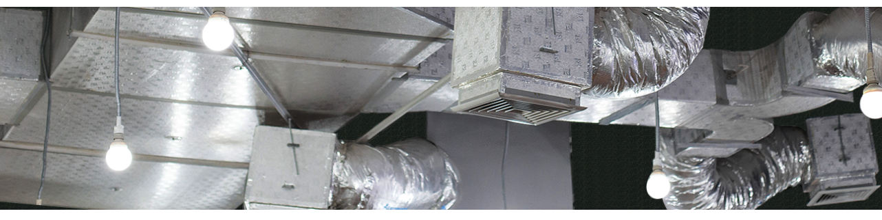

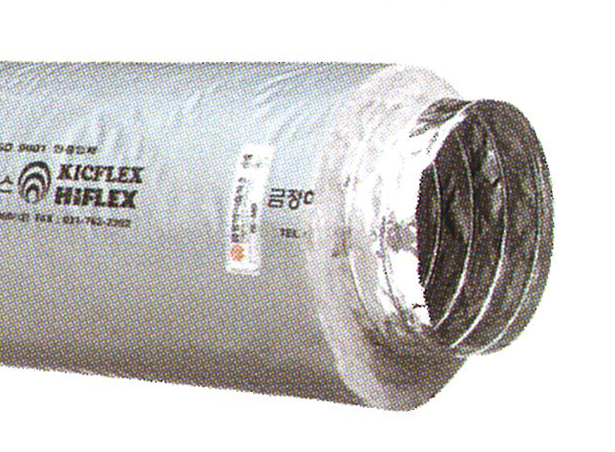
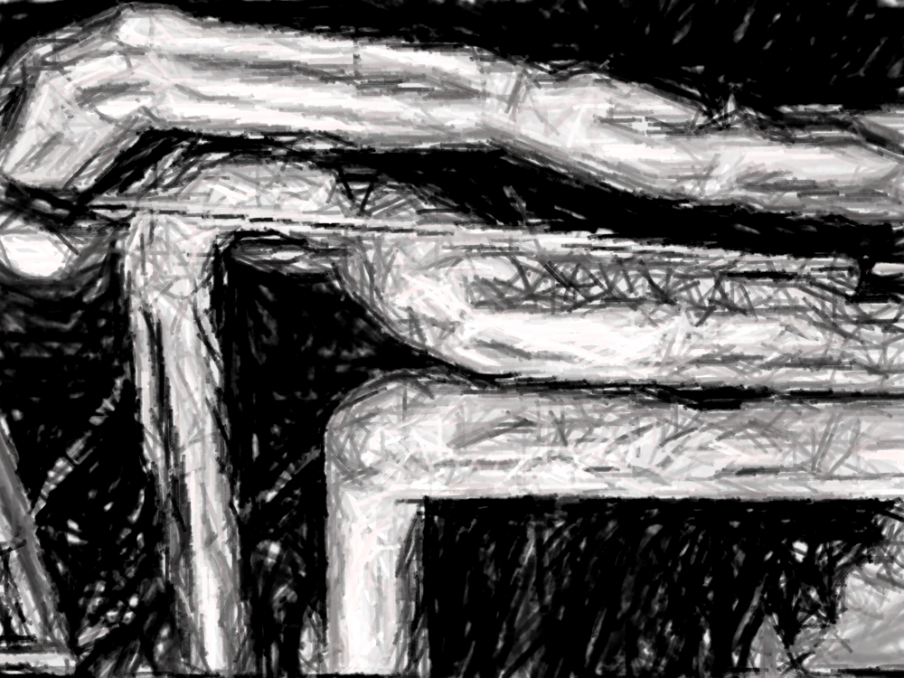
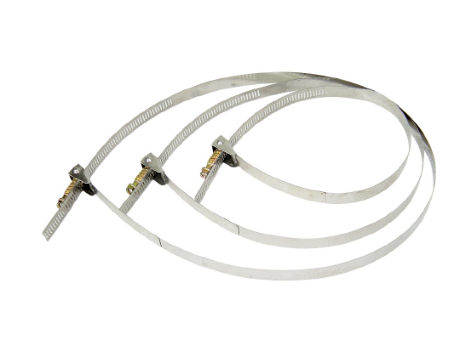
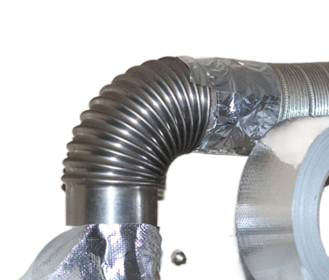
Company Profile
Based on half a century of experience from 1976 ,
Kohnan Chemical Inc.
tailored to your needs from duct core materials to all kinds of insulation materials, skin materials, various jackets, various tapes, barrier materials, and desiccants, all duct materials and packaging materials,
we will customize to meet your needs and
we are always ready deliver to you.
Kohnan Chemical Inc.
©2023 Kohnan Chemical Inc.

Slide 2

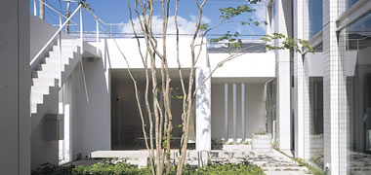
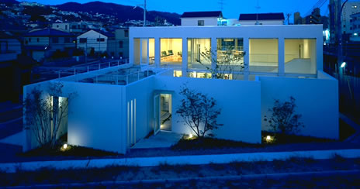
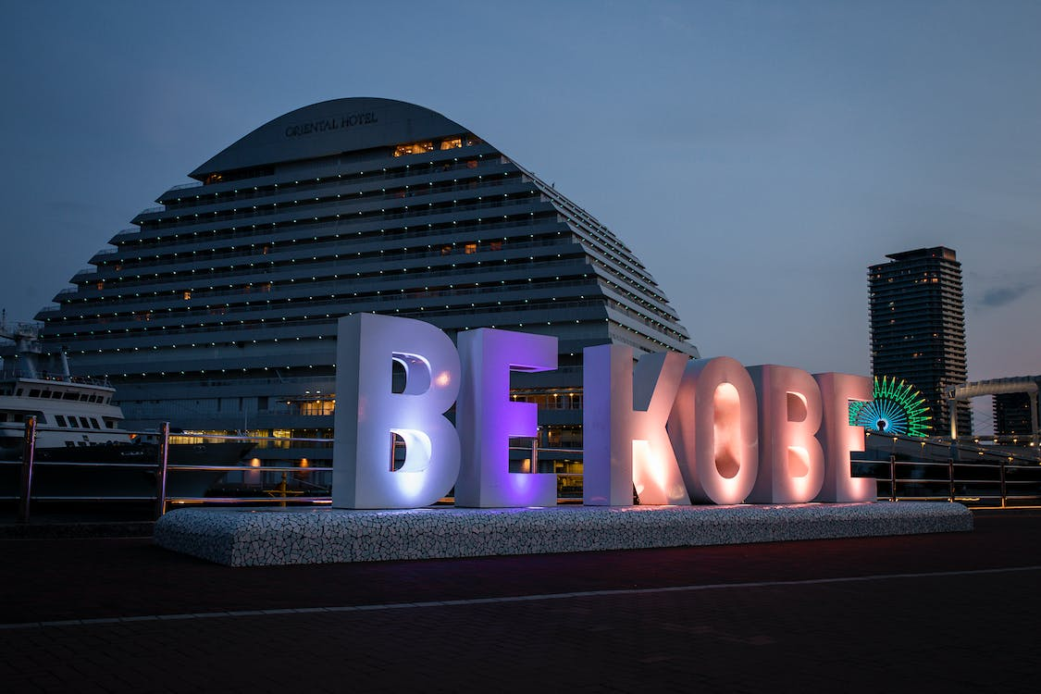
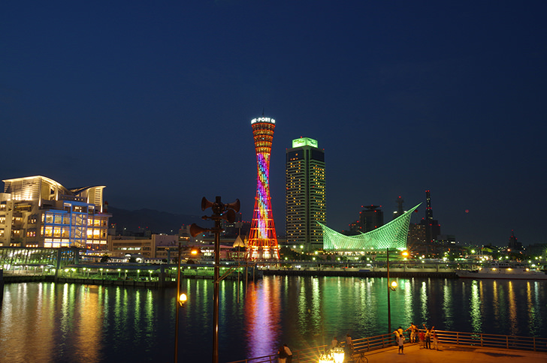
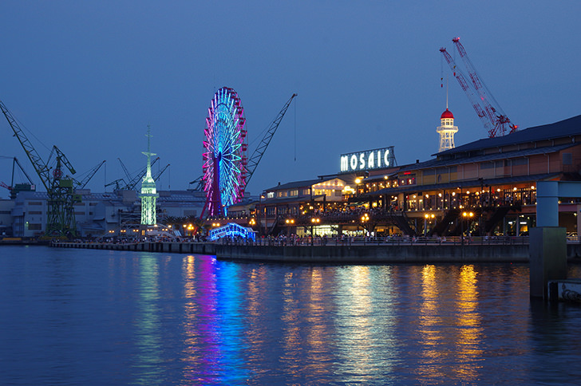
Company Profile
Kohnan Chemical Inc.
Head Office： 5-9-14 Takaha-cho, Nada-ku, Kobe, Hyogo, Japan, 657-0023
℡ 078-854-0008 Fax 078-822-1178
Mikage office： 3-2-11 Mikage, Higashinada-ku, Kobe, Hyogo, Japan
658-0047
President & CEO： Shoichi Ijuin
Founded： November 1976
Paid-in Capital： JPY 20mil (As of Mar 2023)

Slide 3
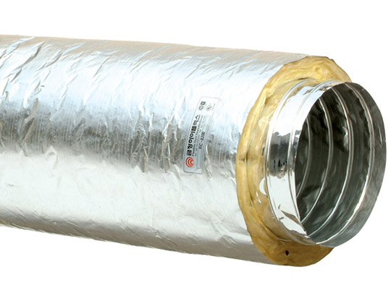
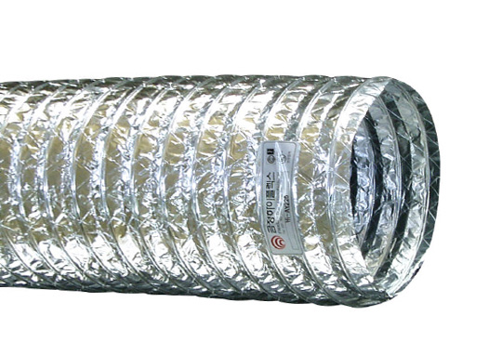
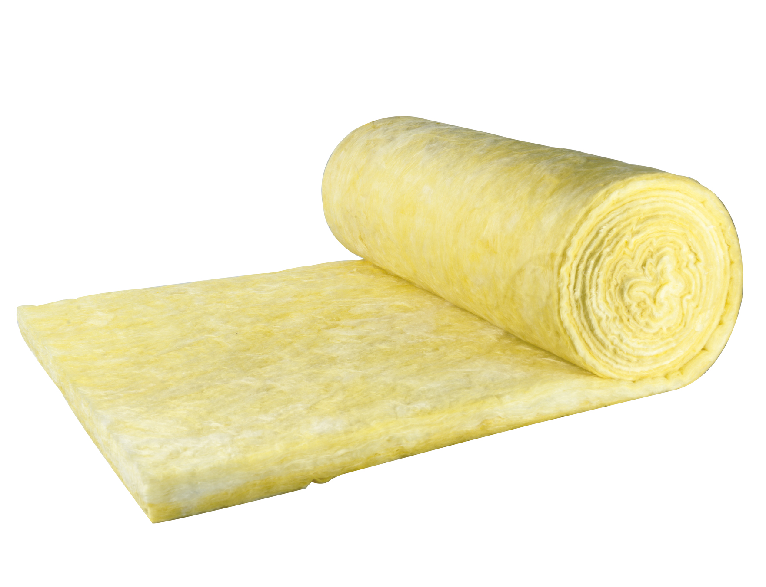
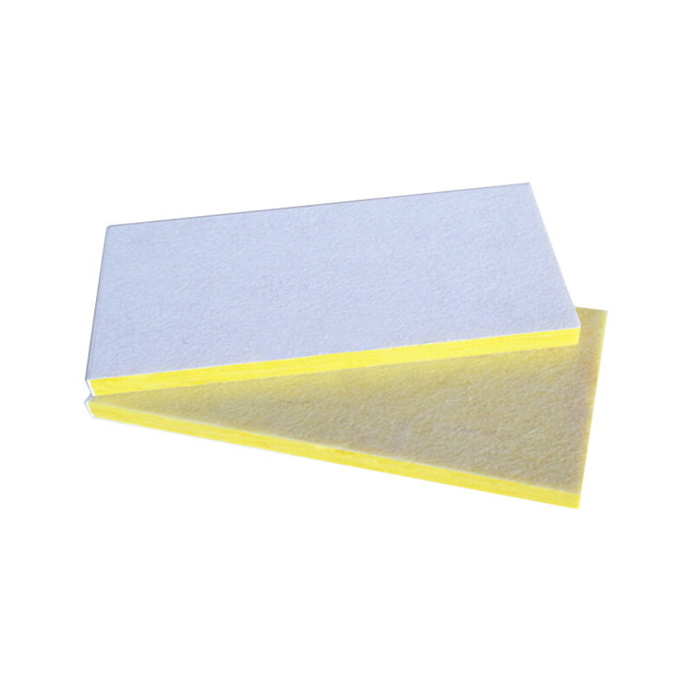
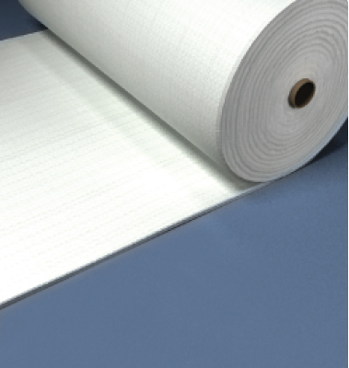
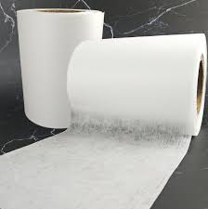
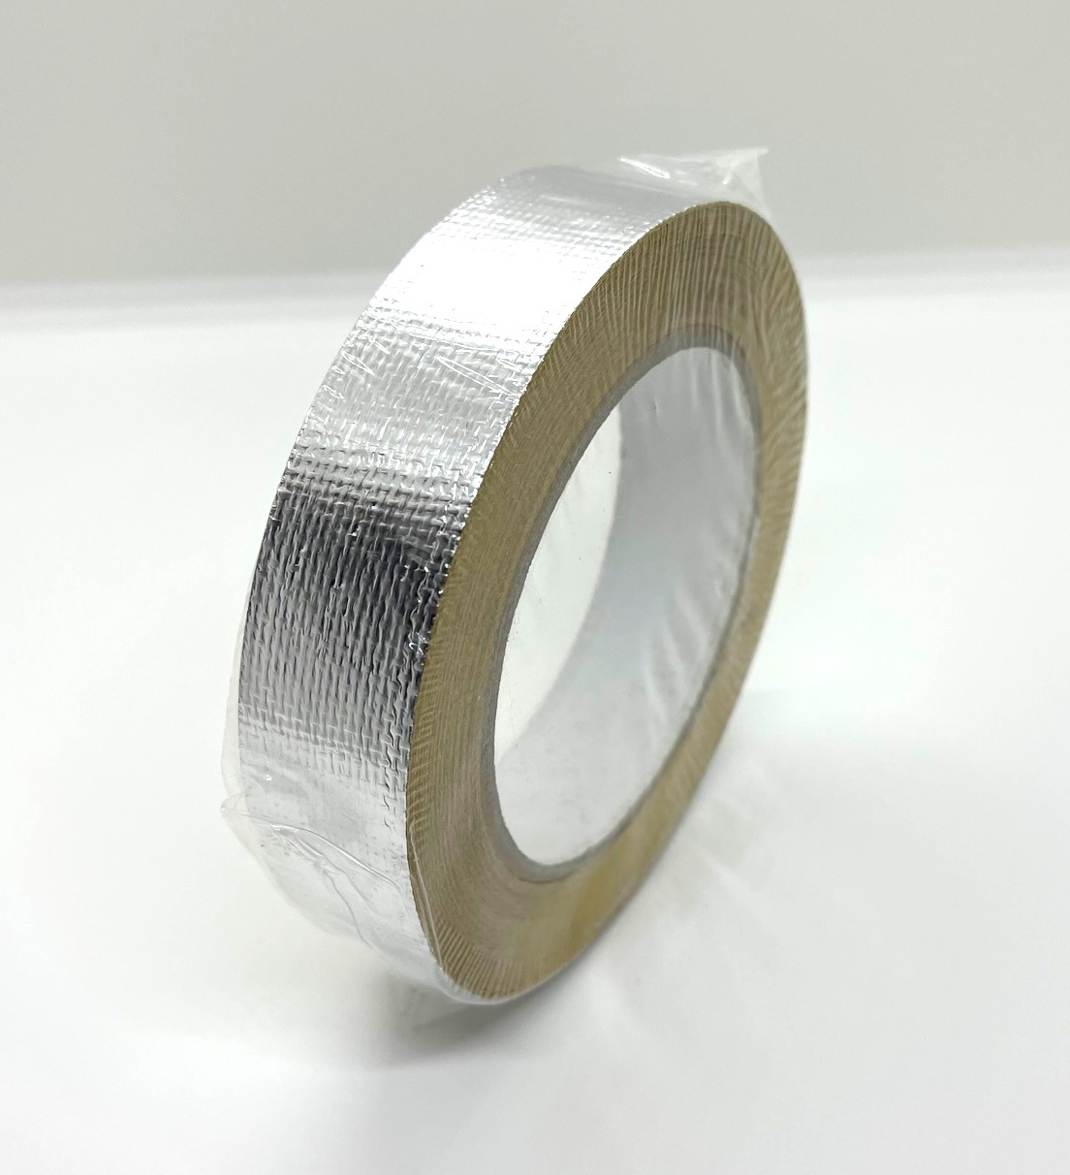
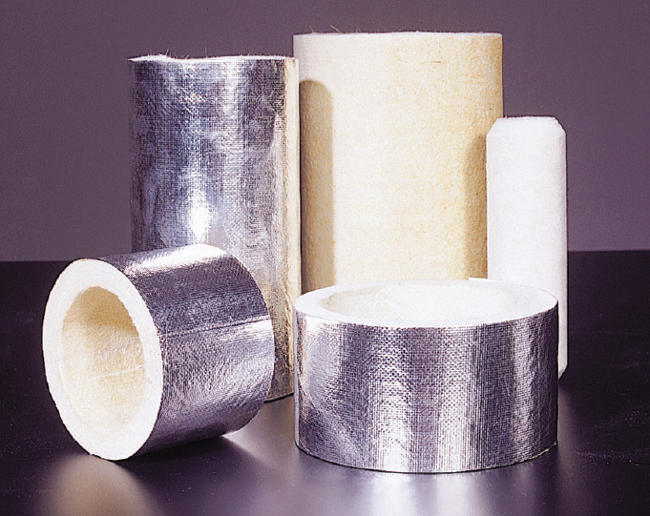
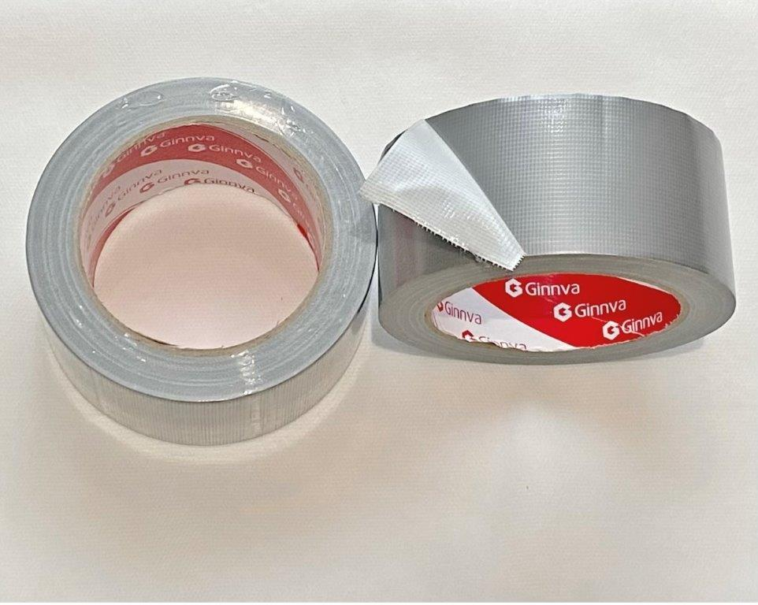
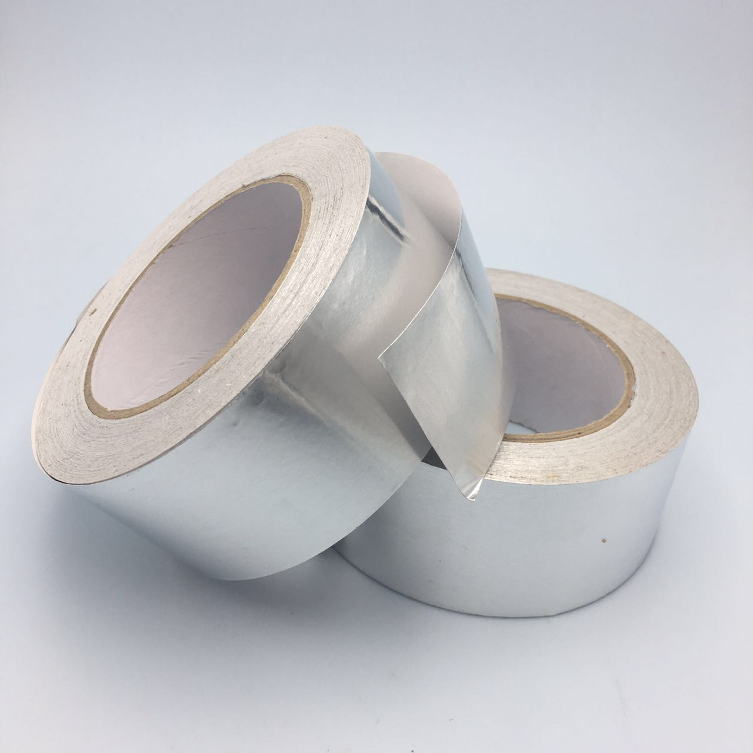
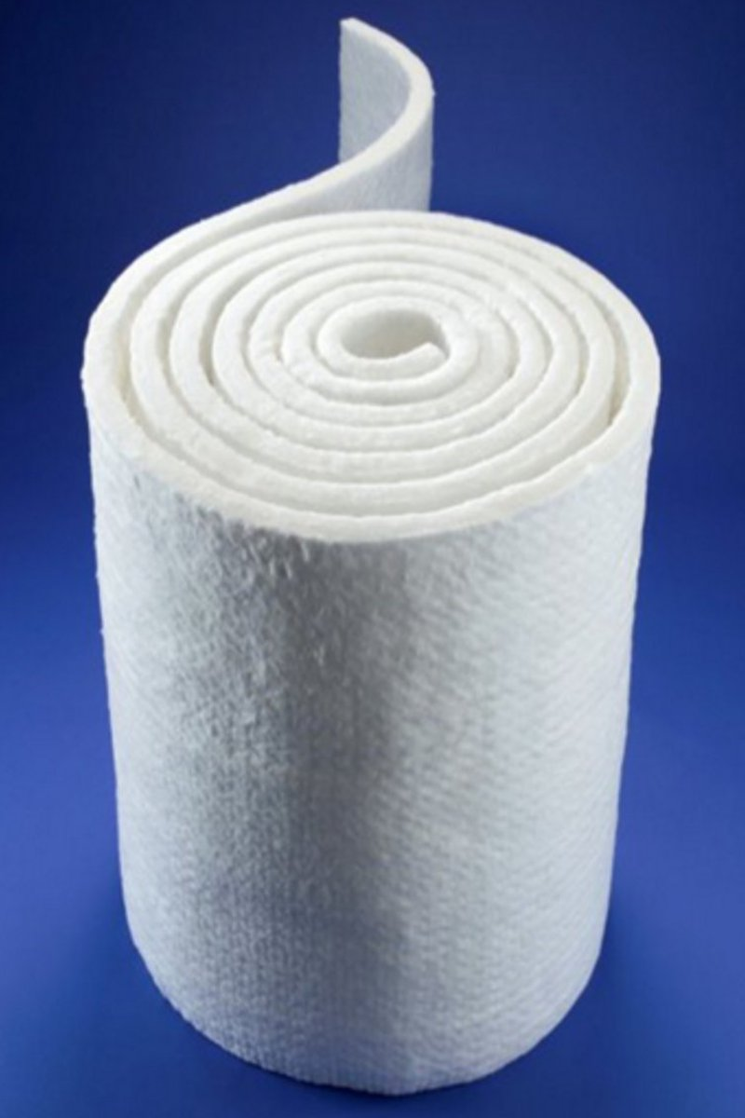
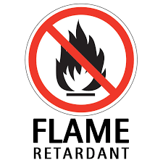
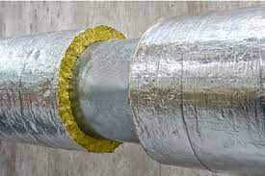
Main products and services － Air duct
Duct Machine（Clip-type）: Clip＝Galvanized steel 0.5ｍｍ×5mm
Flame retardant tube: L-LDPE 80µ and others (Silver) Contains flame retardant
Insulation materials: E glass (softening point 840°C), Glass wool substitute
Flame-retardant PET wool: Substitute for glass wool
Flame retardant: for PE antimony trioxide + ethylene bis (pentabromobenzene)
SUS connection band: Temporary fixing type, various diameters available
Non-woven fabric: PET non-woven fabric 40g/m, 2,000m roll
PET/PE two-component non-woven fabric, heat-sealable
Aluminum jacket: AL/PET with glass yarn
Adhesive tape: Aluminum tape, ALGC tape, ALY tape (with glass yarn), Cloth tape (silver), Butyl tape (flame-retardant products are also available)
Others: Various high-performance insulation materials (silica felt, aerogel),
flame-retardant rubber foam

Slide 4
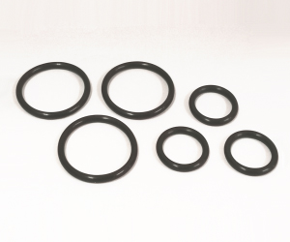

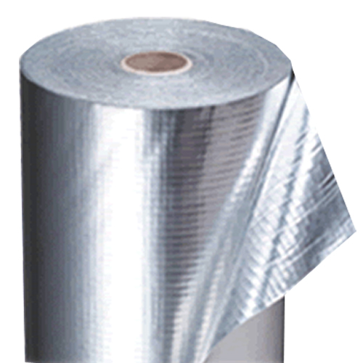
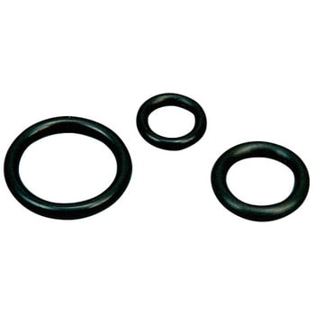
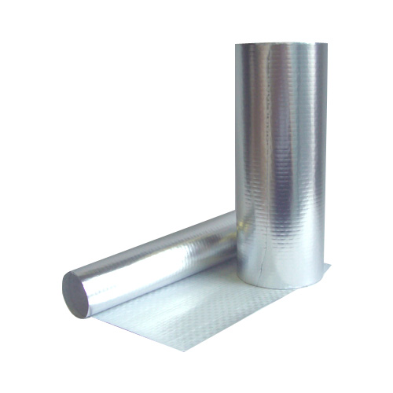
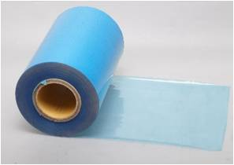
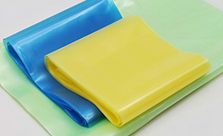
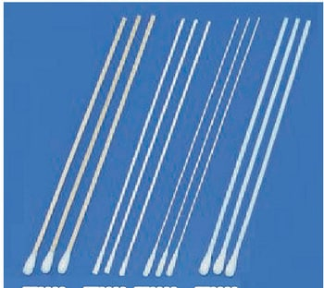
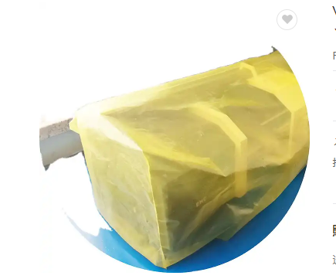
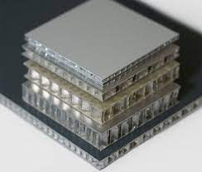
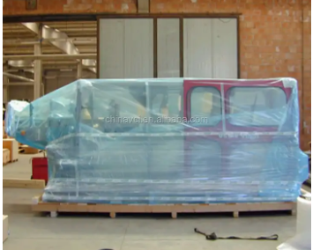
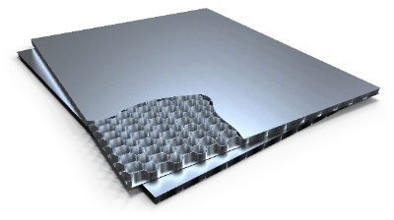
Other products（Ⅰ）
O-ring: EPDM black various , JIS B 2401 equivalent product
VCI film/Paper: ・VCI paper, maximum width: 3,100 mm
・VCI film, maximum width: 3,100 mm
Cotton swab ・plastic stem 6 inches long
・Aluminum shaft 6 inches long
Moisture-proof and waterproof barrier material：
AL deposited PET film/PE cloth/PE (for packing heavy items, etc.)
W1,250mm×50m W1,500m×50m
Others： Various types of aluminum honeycomb boards
(for tunnel wall materials, vehicle floor materials, etc.)

Slide 5
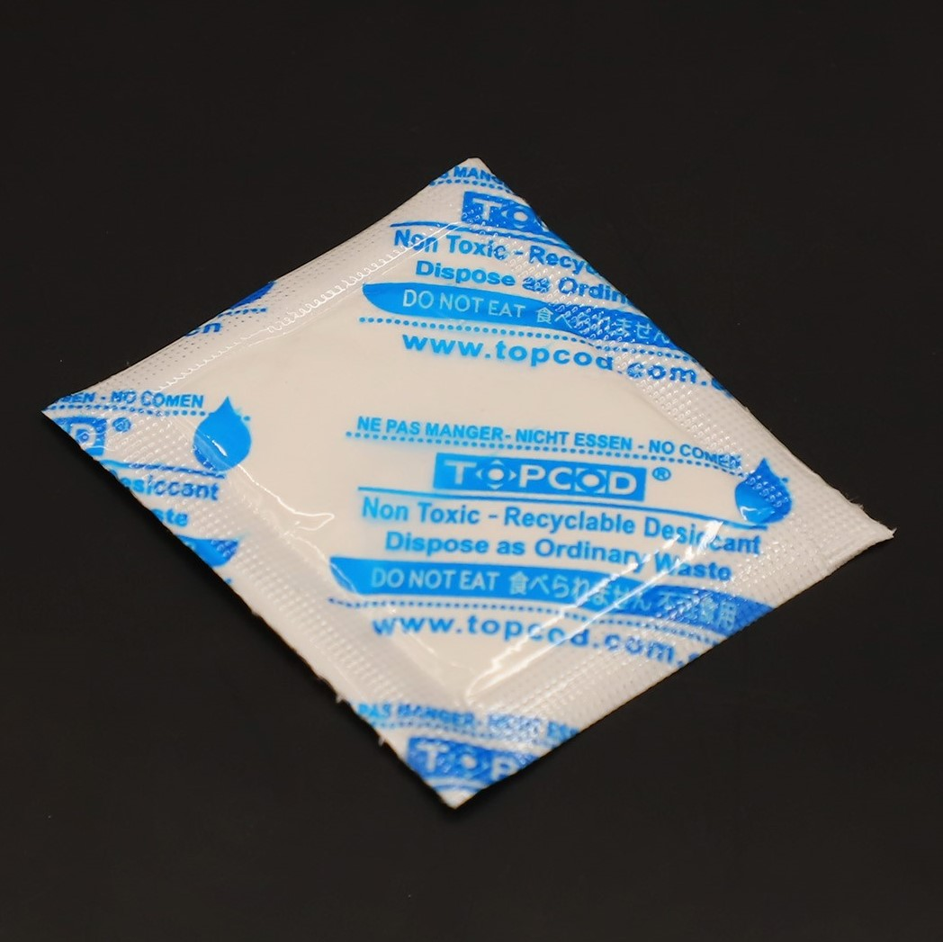
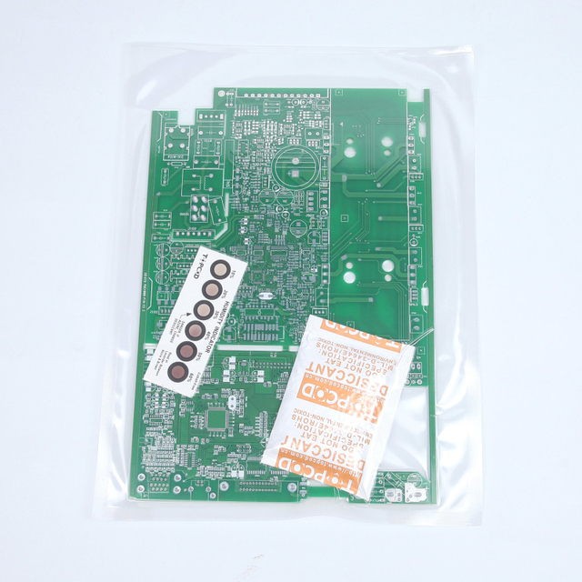
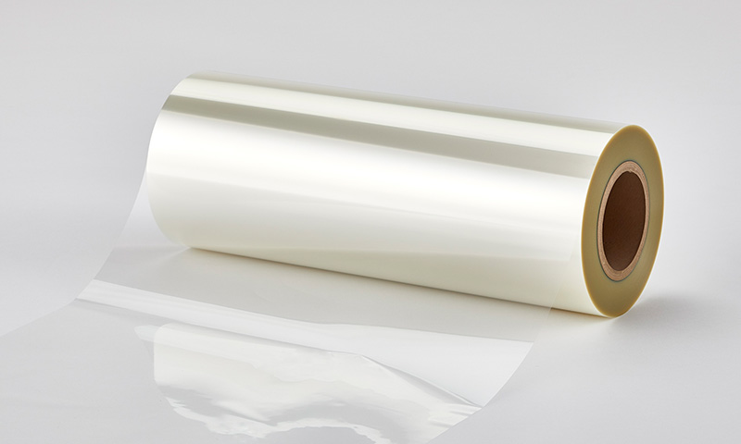
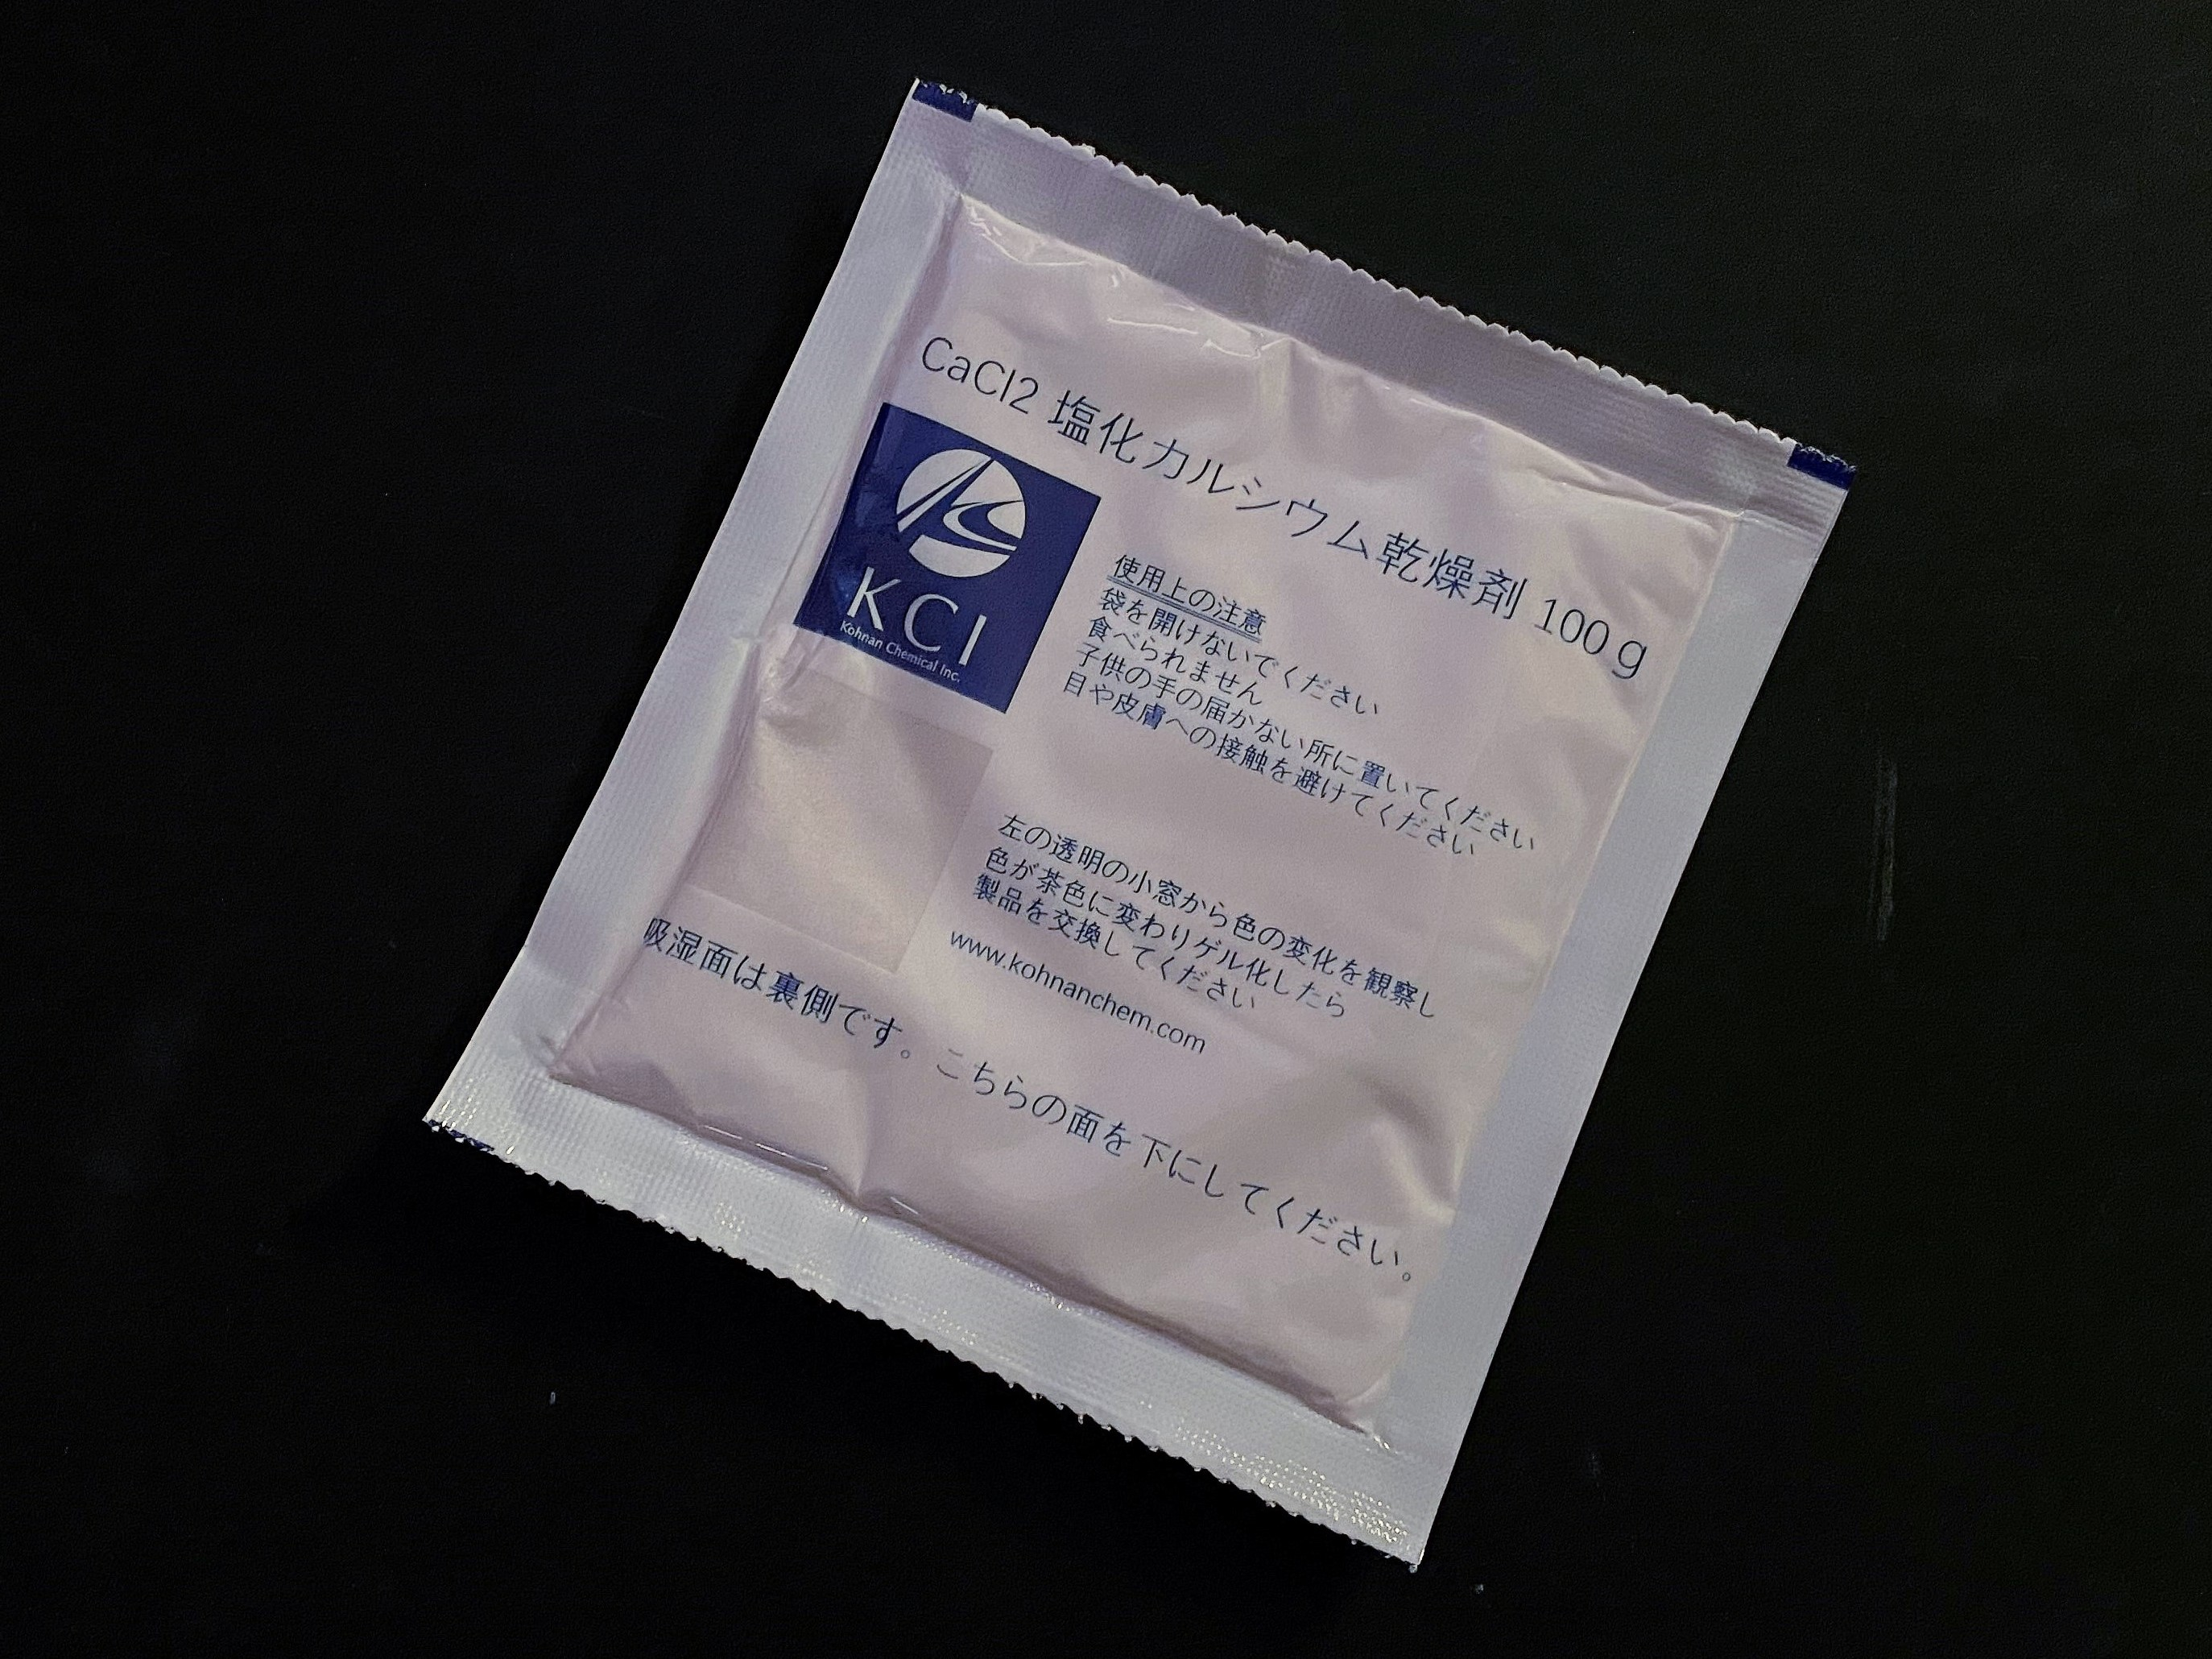
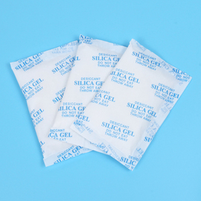
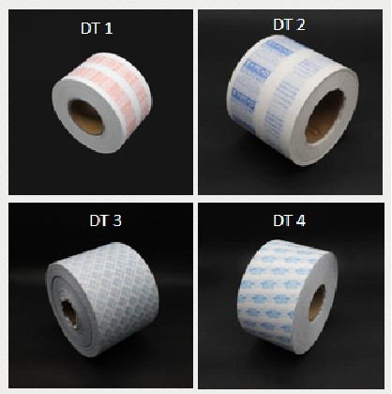
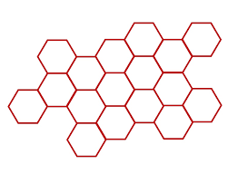
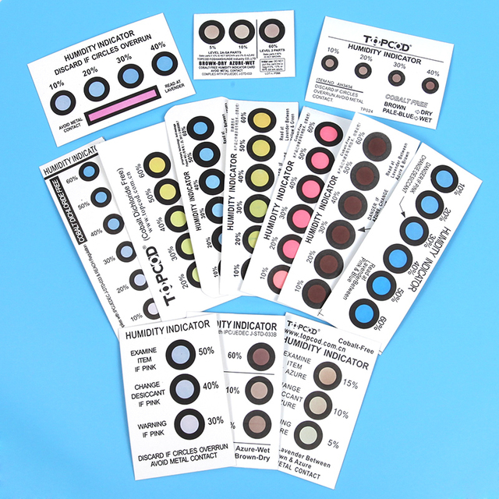
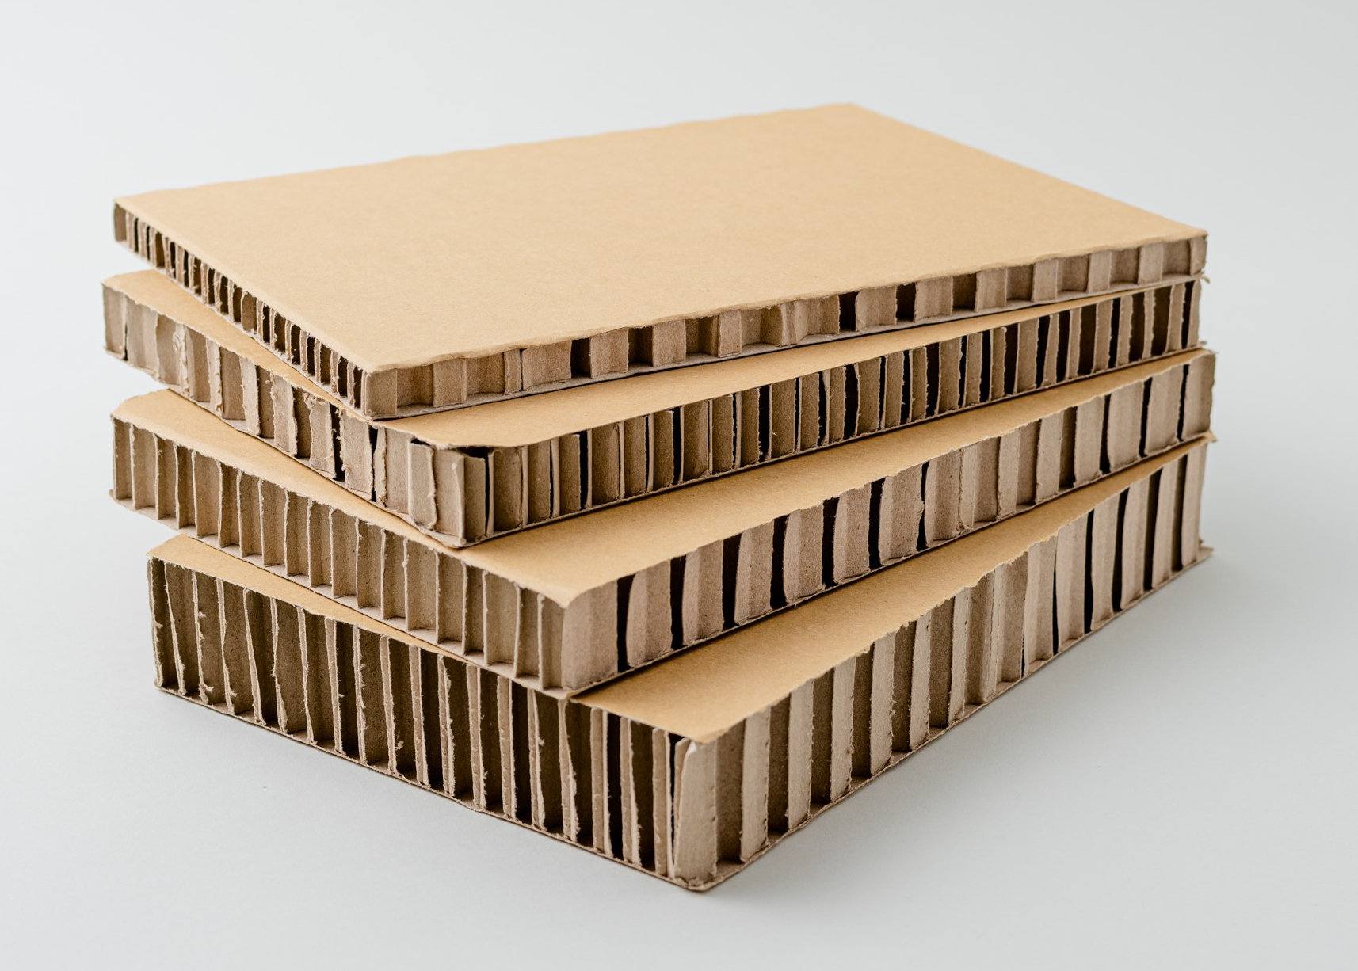
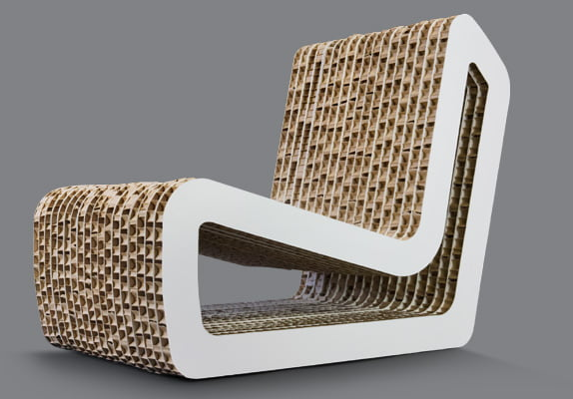
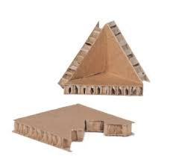
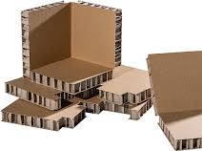
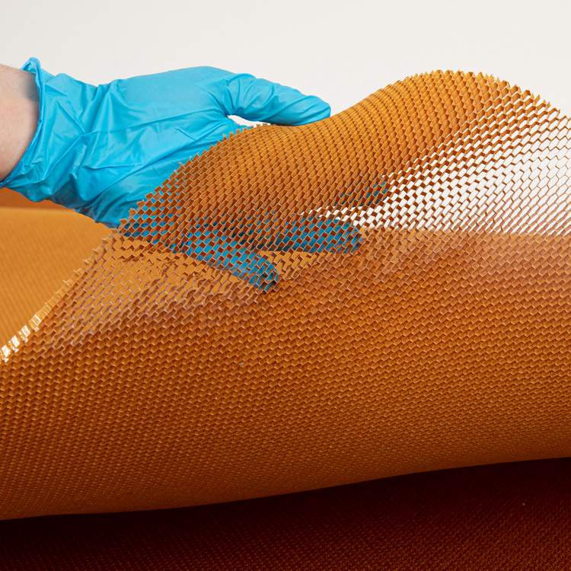
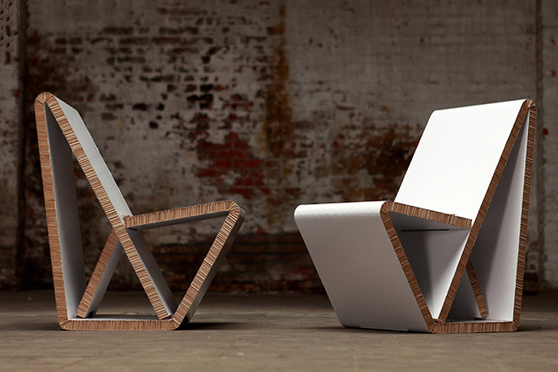
Other products（Ⅱ）
PET film ・ 20µ, 38µ, 50µ 1,020mm x 6,000m winding
・ 75µ 1,020mm x 4,000m winding
Desiccant ・ Silica gel Type A/Type B Blue gel/Orange gel
・ Calcium chloride (+STARCH) moisture absorption rate 200%
*Gelling after moisture absorption, discoloration to brown
・ Humidity display card
Honeycomb board ・ Reinforced cardboard, pallets, wooden boxes,
heavy packaging (Excellent pressure resistance)
・ Air purifiers, clean room filters
・Furniture, core materials for doors
<Honeycomb board applied product>
・Various corner (edge) protectors
・Flexible honeycomb core that bends freely

Slide 6
This material is solely for the use of client personnel. No part of this material may be circulated, quoted, or reproduced for distribution outside the client organization without prior written approval from Kohnan Chemical Inc.

